Slide 1
Overview of TestNG Framework
Ritesh Sachdeo, Nagpur GDC

Slide 2
What we are going to cover in this session?
Overview of TestNG Framework
Introduction
Benefits of TestNG
Steps to Install TestNG
First Test Case with TestNG
Annotations, Groups, & DependOn
Test Cases Prioritizing & Sequencing
TestNG Reporters & Asserts
TestNG Parameters & Data Provider
TestNG DataProvider with Excel
Multi Browser & Parallel Testing
TestNG Listeners

Slide 3
Introduction
TestNG is a testing framework inspired from JUnit and NUnit but introducing some new functionality that make it more powerful and easier to use.
It is an open source automated testing framework; where NG of TestNG means Next Generation. TestNG is similar to JUnit but it is much more powerful than JUnit but still it’s inspired by JUnit. It is designed to be better than JUnit, especially when testing integrated classes. Pay special thanks to Cedric Beust who is the creator of TestNG.
TestNG eliminates most of the limitations of the older framework and gives the developer the ability to write more flexible and powerful tests with help of easy annotations, grouping, sequencing & parametrizing.

Slide 4
Benefits of TestNG
There are number of benefits but from Selenium perspective, major advantages of TestNG are :
It gives the ability to produce HTML Reports of execution
Annotations made testers life easy
Test cases can be Grouped & Prioritized more easily
Parallel testing is possible
Generates Logs
Data Parameterization is possible

Slide 5
Steps to Install TestNG
It is easy to install TestNG, as it comes as a plugin for Eclipse IDE. Prerequisite for installing TestNG is your Internet connection should be up & running during installation of this plugin and Eclipse IDE should be installed in your computer. Please see Download and Install Eclipse to setup Eclipse to you system

Slide 6
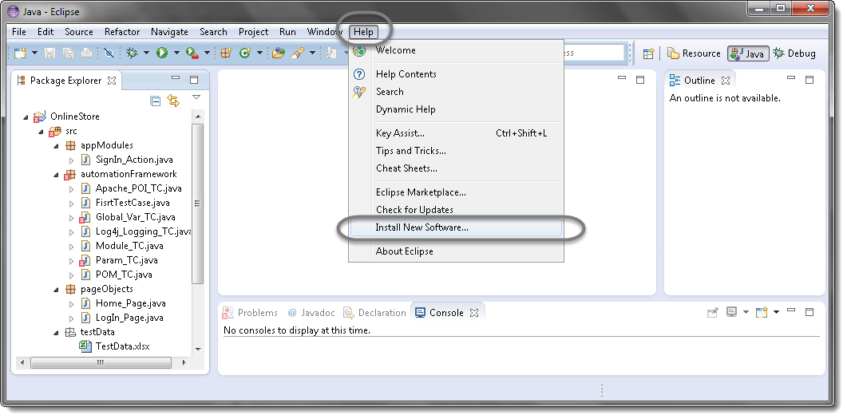
Steps to follow: 1) Launch the Eclipse IDE and from Help menu, click “Install New Software”.

Slide 7
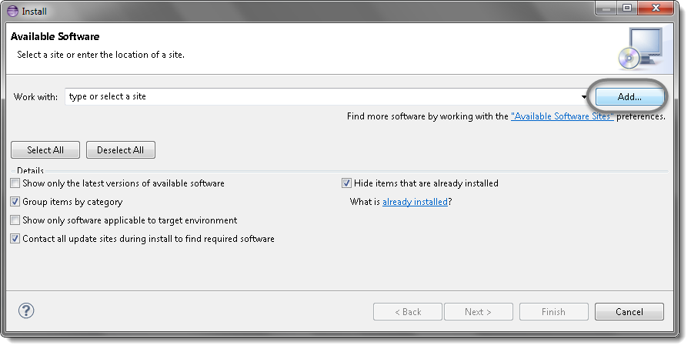
2) You will see a dialog window, click “Add” button.

Slide 8
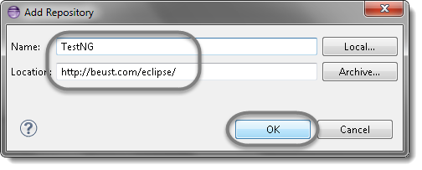
3) Type name as you wish, lets take “TestNG” and type “http://beust.com/eclipse/” as location. Click OK.

Slide 9
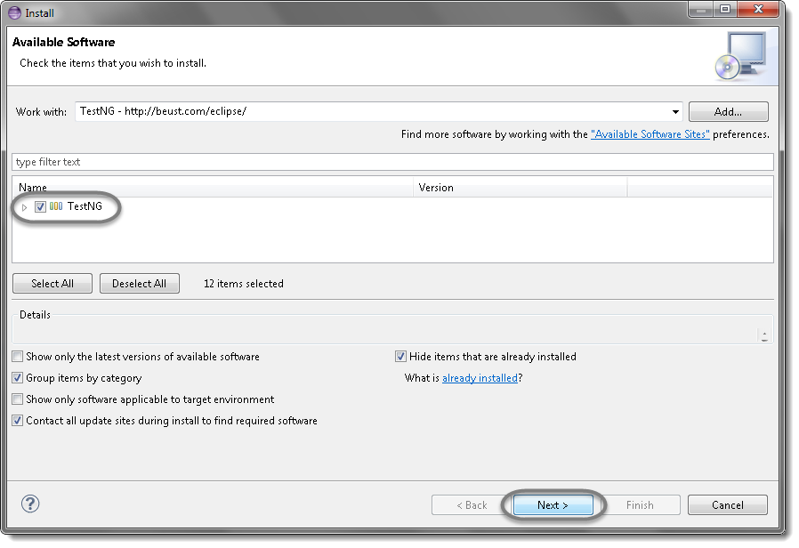
4) You come back to the previous window but this time you must see TestNG option in the available software list. Just Click TestNG and press “Next” button.

Slide 10
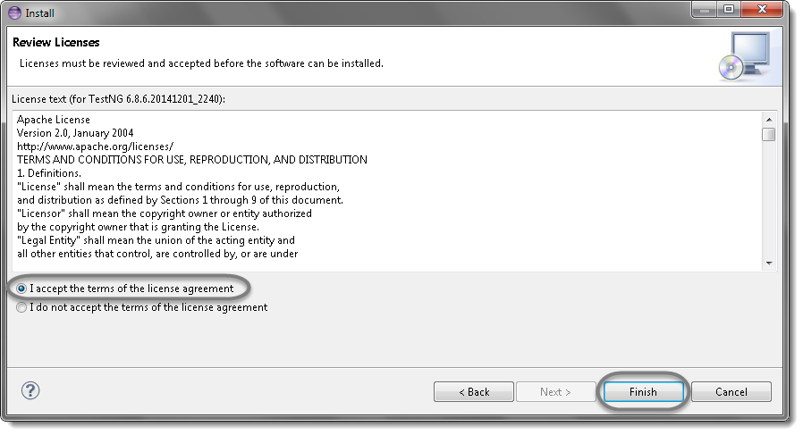
5) Click “I accept the terms of the license agreement” then click Finish.

Slide 11
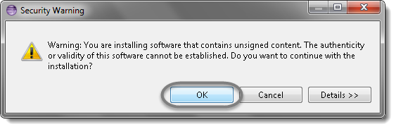
6) You may or may not encounter a Security warning, if in case you do just click OK.

Slide 12
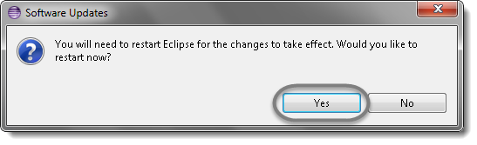
7) Click Next again on the succeeding dialog box until it prompts you to Restart the Eclipse. 8) You are all done now, just Click Yes.

Slide 13
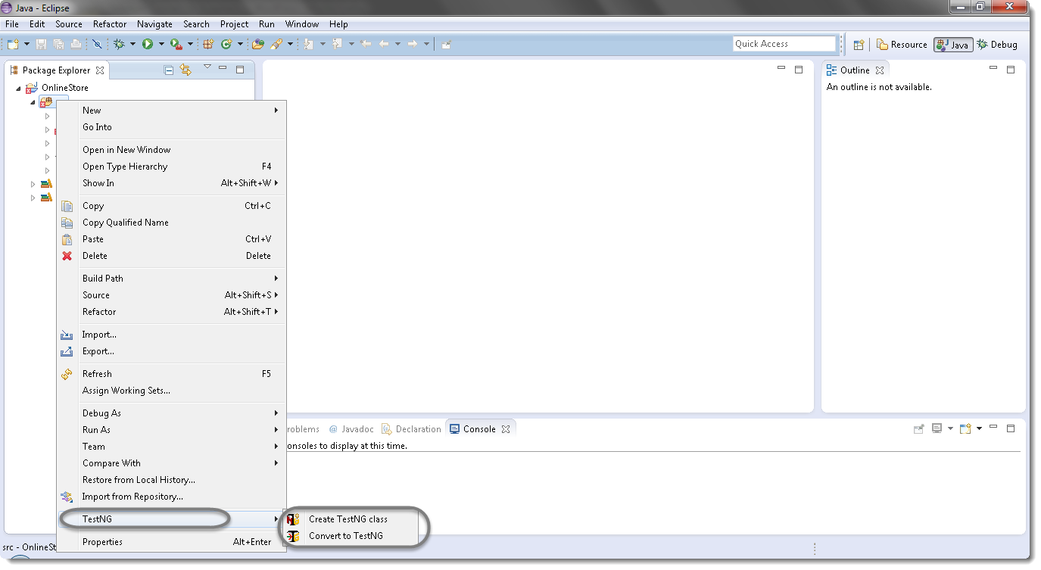
9) Proceed with your workplace. 10) After restart, verify if TestNG was indeed successfully installed. Right click on you project and see if TestNG is displayed in the opened menu.

Slide 14
First Test Case with TestNG
Steps to follow:
Press Ctrl+N , select “TestNG Class” under TestNG category and click Next.
OR
Right click on Test Case folder, go to TestNG and select “TestNG Class“.

Slide 15
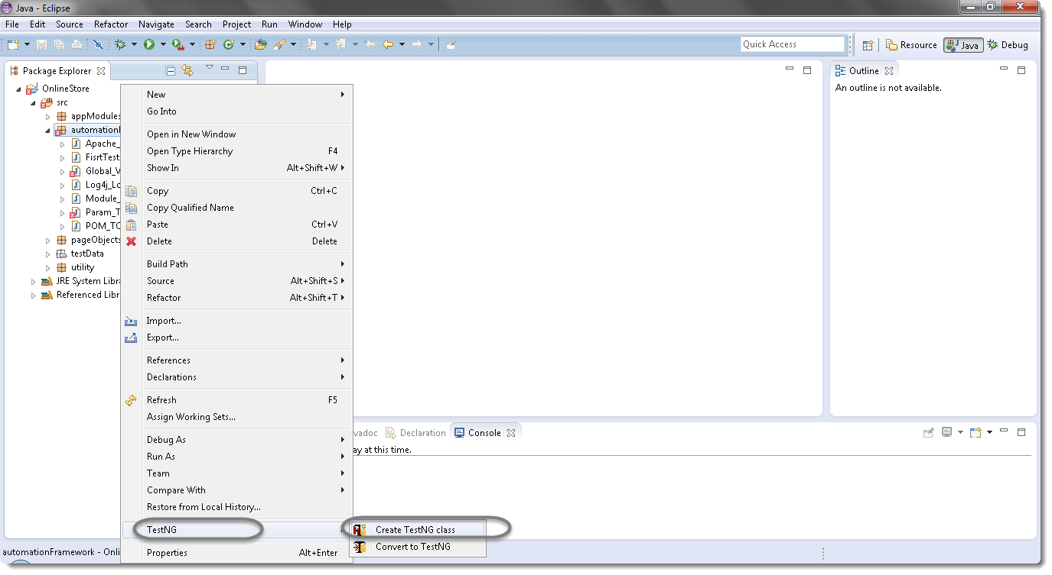

Slide 16
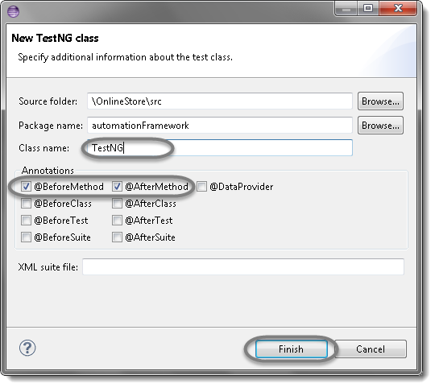
2) If your project is set up and you have selected the Test Case folder before creating TestNG class then the source folder and the package name will be prepopullated on the form. Set class name as ‘TestNG‘. Under Annotations, check “@BeforeMethod”, “@AfterMethod” and click Finish. That’s it.

Slide 17
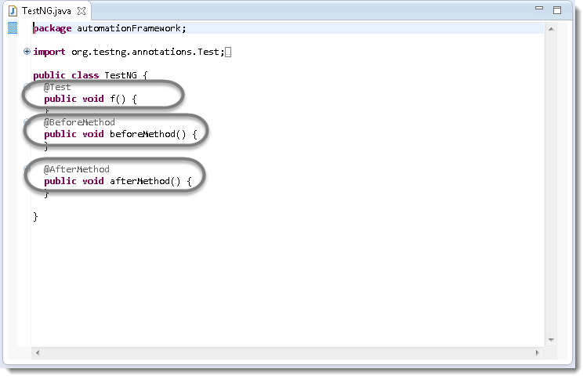
3) Now it will display the newly created TestNg class under the Test Case package(folder). TestNG class will look like the image below with displaying three empty methods. One method f() by default and before & after method, as selected during the creation of the class.

Slide 18
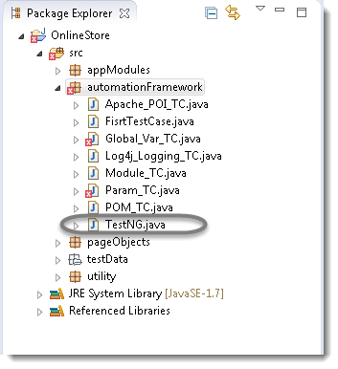
4) Project explorer will look like this with TestNG class.
Now it is the time to write the first TestNG test case.

Slide 19
5) Let’s take an example of First Test Case and divide the test case in to three parts . @BeforeMethod : Launch Firefox and direct it to the Base URL @Test : Enter Username & Password to Login, Print console message and Log out @AfterMethod : Close Firefox browser 6) Program : package automationFramework; import org.testng.annotations.Test; import org.testng.annotations.BeforeMethod; import java.util.concurrent.TimeUnit; import org.openqa.selenium.By; import org.openqa.selenium.WebDriver; import org.openqa.selenium.chrome.ChromeDriver;

Slide 20
import org.testng.annotations.AfterMethod; public class TestNG { public WebDriver driver; @Test public void main(){ driver.findElement(By.linkText("Sign In")).click(); // Find the element that's ID attribute is ‘email' (emailAddress) // Enter Username on the element found by above desc. driver.findElement(By.id("email")).sendKeys("monika.assudani@perficient.com"); // Find the element that's ID attribute is ‘pass' (Password) // Enter Password on the element found by the above desc.

Slide 21
driver.findElement(By.id("pass")).sendKeys("monika@123"); // Now submit the form. WebDriver will find the form for us from the element driver.findElement(By.id("send2")).click(); // Print a Log In message to the screen System.out.println(" Login Successfully"); } @BeforeMethod public void beforeMethod() { // Create a new instance of the chrome driver System.setProperty("webdriver.chrome.driver","C:\\NewFrameWorkAutomation\\POM\\lib\\chromedriver.exe"); driver = new ChromeDriver();

Slide 22
//Put a Implicit wait, this means that any search for elements on the page could take the time the implicit wait is set for before throwing exception driver.manage().timeouts().implicitlyWait(10, TimeUnit.SECONDS); //Launch the magento default Website driver.get("http://magento2-demo.nexcess.net/"); driver.manage().window().maximize(); } @AfterMethod public void afterMethod() { // Close the driver driver.quit(); } }

Slide 23
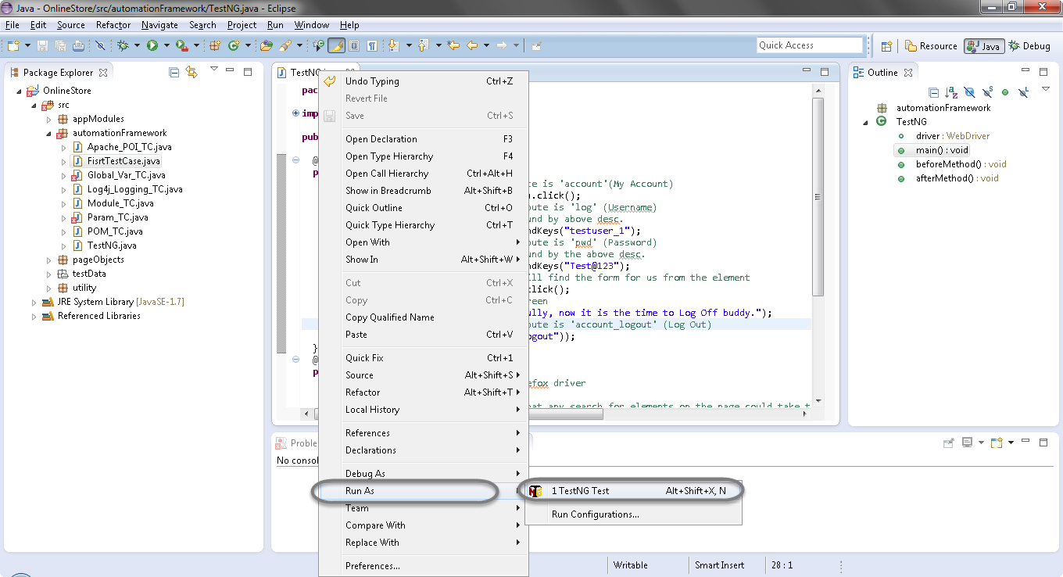
6) Run the test by right click on the test case script and select Run As > TestNG Test.

Slide 24
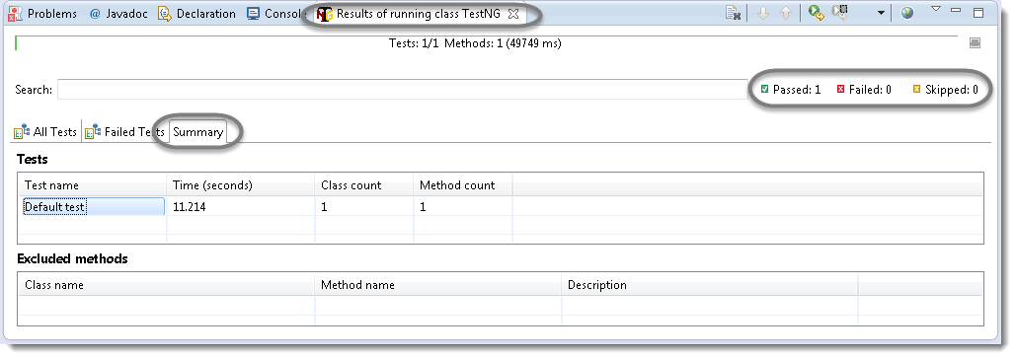
7) Give it few minutes to complete the execution, once it is finished the results will look like this in the TestNg Result window.

Slide 25
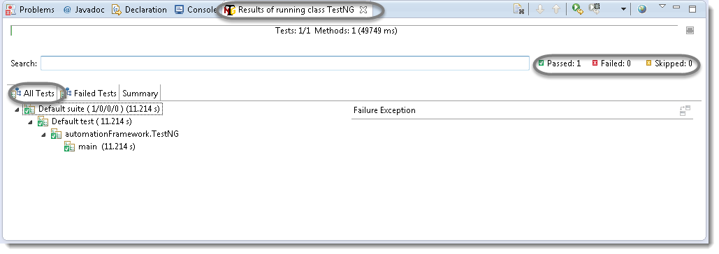
It displayed ‘passed : 1’. This means test is successful and Passed. There are 3 sub tabs. “All Tests”, “Failed Tests” and “Summary”. Just click “All Tests” to see what is there.

Slide 26
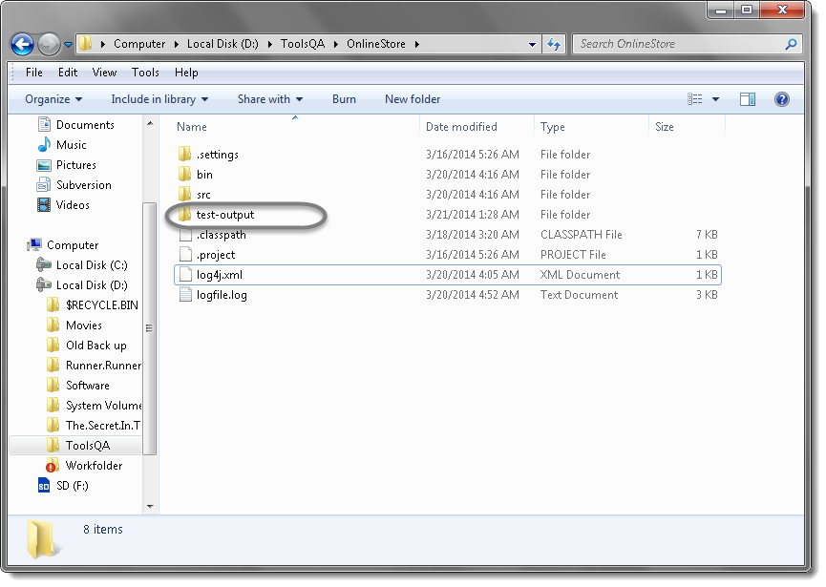
8) TestNG also produce HTML reports. To access those reports go to the Projectdirectory and open test- output folder.

Slide 27
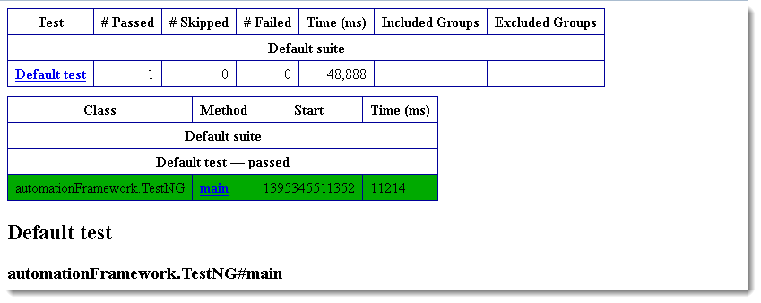
9) Open ‘emailable-report.html‘, as this is a html report open it with browser.

Slide 28
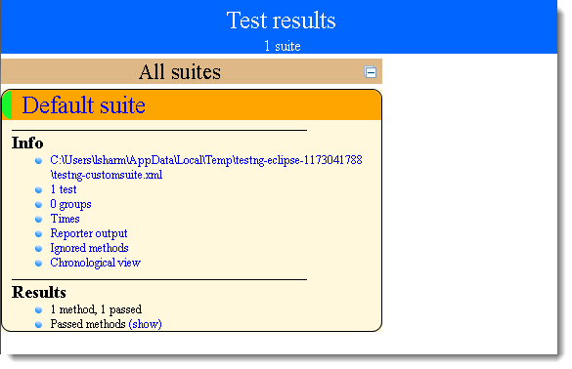
10) TestNG also produce ‘index.html‘ report and it resides in the same test-output folder. This reports gives the link to all the different component of the TestNG reports like Groups & Reporter Output. On clicking these will display detailed descriptions of execution. In the advance chapter of TestNG we will go though each of the TestNG topics.

Slide 29
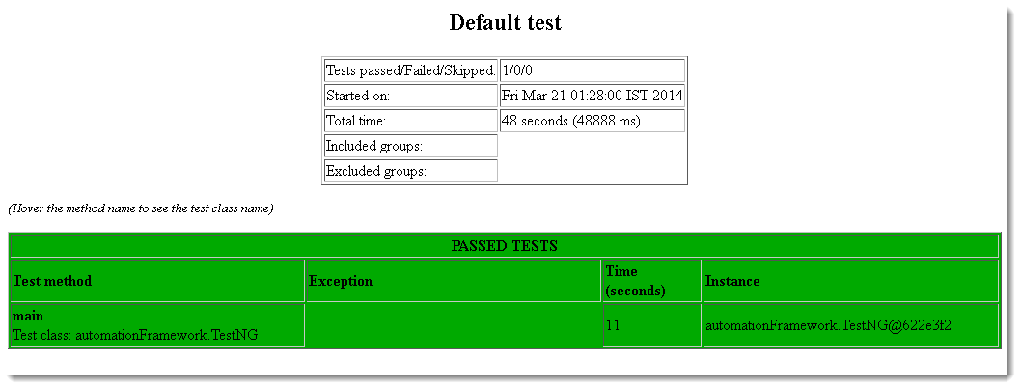

Slide 30
Annotations, Groups, & DependOn
TestNG Annotations
In the TestNG Introduction chapter we have came across different annotations used in TestNG Framework but so far we have used just three(Before, After & Test). All though these are the most frequently used annotations but who know how far you will go with your framework and may like to use other useful TestNG annotations.
Before that I would like you to give a small idea on Annotations hierarchy or Annotations levels in TestNG.

Slide 31
<suite> <test> <classes> <method> <test> </method> </classes> </test> </suite>
Annotations hierarchy

Slide 32
It says that @Test is the smallest annotation here. @Method will be executed first, before and after the execution of @Test. The same way @Class will be executed first, before and after the execution of @Method and so on.
Now with the below example it will be clear to you easily.
Program:
package automationFramework;
import org.testng.annotations.AfterClass;
import org.testng.annotations.AfterMethod;
import org.testng.annotations.AfterSuite;
import org.testng.annotations.AfterTest;
import org.testng.annotations.BeforeClass;
import org.testng.annotations.BeforeMethod;

Slide 33
import org.testng.annotations.BeforeSuite;
import org.testng.annotations.BeforeTest;
import org.testng.annotations.Test;
public class Sequencing {
@Test
public void testCase1() {
System.out.println("This is the Test Case 1");
}
@Test
public void testCase2() {
System.out.println("This is the Test Case 2");
}

Slide 34
@BeforeMethod
public void beforeMethod() {
System.out.println("This will execute before every Method");
}
@AfterMethod
public void afterMethod() {
System.out.println("This will execute after every Method");
}
@BeforeClass
public void beforeClass() {
System.out.println("This will execute before the Class");
}

Slide 35
@AfterClass
public void afterClass() {
System.out.println("This will execute after the Class");
}
@BeforeTest
public void beforeTest() {
System.out.println("This will execute before the Test");
}
@AfterTest
public void afterTest() {
System.out.println("This will execute after the Test");
}

Slide 36
@BeforeSuite
public void beforeSuite() {
System.out.println("This will execute before the Test Suite");
}
@AfterSuite
public void afterSuite() {
System.out.println("This will execute after the Test Suite");
}
}

Slide 37
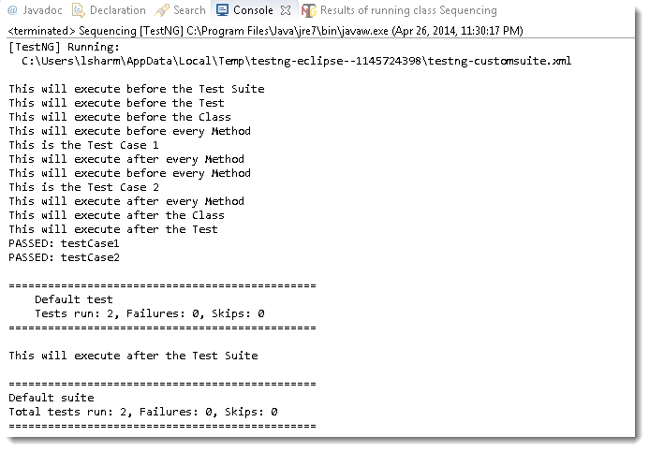
Output of the above code will be like this:

Slide 38
Test Case Grouping
‘Groups‘ is one more annotation of TestNG which can be used in the execution of multiple tests. Let’s say you have hundred tests of class vehicle and in it ten method of car, ten method of scooter and so on. You probably like to run all the scooter tests together in a batch. And you want all to be in a single test suite. With the help of grouping you can easily overcome this situation.
Scenario:
Create two methods for Car, two methods for Scooter and one method in conjunction with Car & Sedan Car.
Group them separately with using (groups = { ” Group Name” })

Slide 39
Program:
package automationFramework;
import org.testng.annotations.Test;
public class Grouping {
@Test (groups = { "Car" })
public void Car1() {
System.out.println("Batch Car - Test car 1");
}
@Test (groups = { "Car" })
public void Car2() {
System.out.println("Batch Car - Test car 2");
}

Slide 40
@Test (groups = { "Scooter" })
public void Scooter1() {
System.out.println("Batch Scooter - Test scooter 1");
}
@Test (groups = { "Scooter" })
public void Scooter2() {
System.out.println("Batch Scooter - Test scooter 2");
}
@Test (groups = { "Car", "Sedan Car" })
public void Sedan1() {
System.out.println("Batch Sedan Car - Test sedan 1");
}
}

Slide 41
Create a testng xml like this:
<suite name="Suite">
<test name="Practice Grouping">
<groups>
<run>
<include name="Car" />
</run>
</groups>
<classes>
<class name="automationFramework.Grouping" />
</classes>
</test>
</suite>

Slide 42
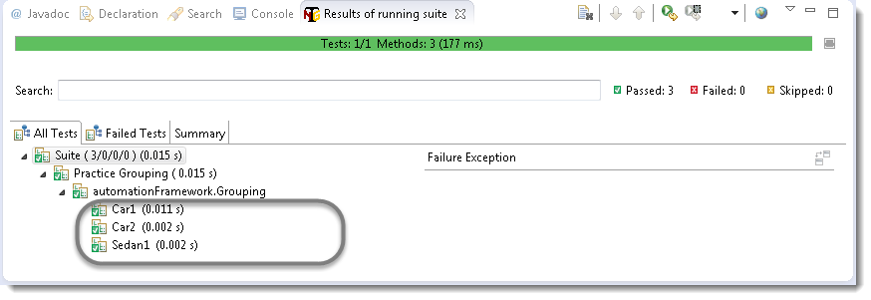
Run the test by right click on the testng.xml file and select Run As > TestNG Suite. Output will be like this in TestNg console:
Note: We have just call the group ‘Car’ from the xml and it also executed the test for Sedan Car, as we have mentioned the ‘Car’ as well while declaring the group of Sedan Car.

Slide 43
Clubbing of groups is also possible, take a look at the below xml:
<suite name="Suite">
<test name="Practice Grouping">
<groups>
<define name="All">
<include name="Car"/>
<include name="Scooter"/>
</define>
<run>
<include name="All"/>
</run>
</groups>
<classes>
<class name="automationFramework.Grouping" />
</classes>
</test>
</suite>

Slide 44
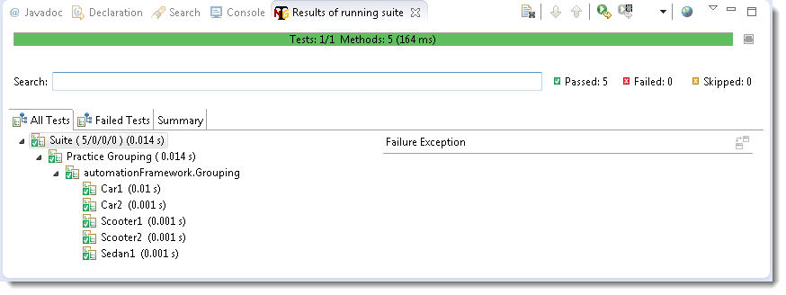
You can see that we have created a new Group with the name ‘All’ and include other groups in it. Then simply called the newly created group for execution. The output will be like this:

Slide 45
Dependent Test
Sometimes, you may need to invoke methods in a Test case in a particular order or you want to share some data and state between methods. This kind of dependency is supported by TestNG as it supports the declaration of explicit dependencies between test methods.
TestNG allows you to specify dependencies either with:
Using attributes dependsOnMethods in @Test annotations OR
Using attributes dependsOnGroups in @Test annotations.
Program
package automationFramework;
import org.testng.annotations.Test;
public class Dependent {

Slide 46
@Test (dependsOnMethods = { "OpenBrowser" })
public void SignIn() {
System.out.println("This will execute second (SignIn)");
}
@Test
public void OpenBrowser() {
System.out.println("This will execute first (Open Browser)");
}
@Test (dependsOnMethods = { "SignIn" })
public void LogOut() {
System.out.println("This will execute third (Log Out)");
}

Slide 47
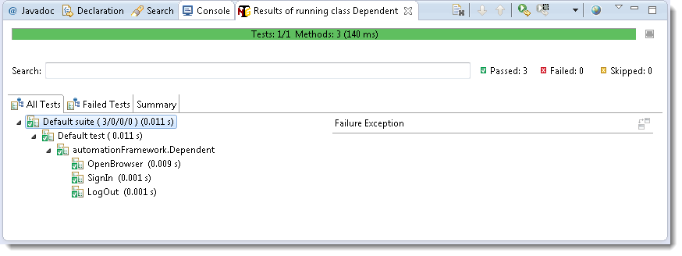
The output will be like this:

Slide 48
Sequencing & Prioritizing
You need to use the ‘priority‘ parameter, if you want the methods to be executed in your order. Parameters are keywords that modify the annotation’s function.
Let’s take the same above example and execute all @Test methods in right order. Simply assign priority to all @Test methods starting from 0(Zero).
Program:
package automationFramework;
import org.openqa.selenium.WebDriver;
import org.testng.annotations.Test;
public class MultipleTest {
public WebDriver driver;

Slide 49
@Test(priority = 0)
public void One() {
System.out.println("This is the Test Case number One");
}
@Test(priority = 1)
public void Two() {
System.out.println("This is the Test Case number Two");
}
@Test(priority = 2)
public void Three() {
System.out.println("This is the Test Case number Three");
}

Slide 50
@Test(priority = 3)
public void Four() {
System.out.println("This is the Test Case number Four");
}
}
Note: TestNG will execute the @Test annotation with the lowest priority value up to the largest.

Slide 51
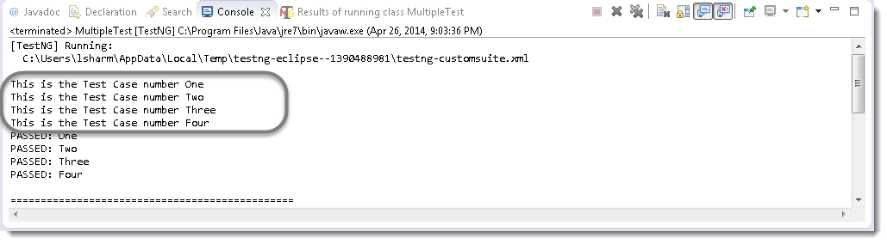
Output of the above:

Slide 52
Skipping a Test Case
Think of a situation where you are required to skip one or more @Test from your testng class. In testng, you can easily able to handle this situation by setting the ‘enabled’ parameter to ‘false’ for e.g.:
@Test(enabled = false)
To use two or more parameters in a single annotation, separate them with a comma:
@Test(priority = 3, enabled = false)
Again take the same example and set the value false for the third test.

Slide 53
Program:
package automationFramework;
import org.openqa.selenium.WebDriver;
import org.testng.annotations.Test;
public class MultipleTest {
public WebDriver driver;
@Test(priority = 0)
public void One() {
System.out.println("This is the Test Case number One");
}

Slide 54
@Test(priority = 1)
public void Two() {
System.out.println("This is the Test Case number Two");
}
@Test(priority = 2, enabled = false)
public void Three() {
System.out.println("This is the Test Case number Three");
}
@Test(priority = 3)
public void Four() {
System.out.println("This is the Test Case number Four");
}
}

Slide 55
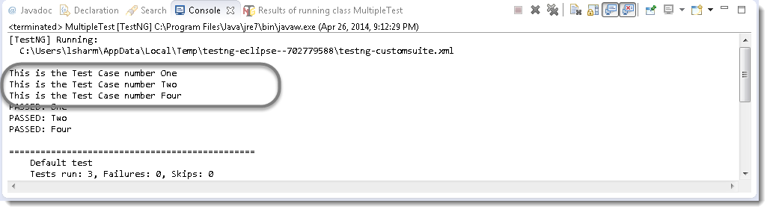
Output of the above example:

Slide 56
TestNG Reporters & Asserts
TestNG Reporters
TestNG is a Framework and so far we have already seen the many different powerful features of TestNG. It almost gives you all the important things you are required to complete the Framework.
It also supports for report logging.
In selenium there are two types of logging. High level logging and Low level logging. In low level logging you try to produce logs for the every step you take or every action you make in your automation script. In high level logging you just try to capture main events of your test.

Slide 57
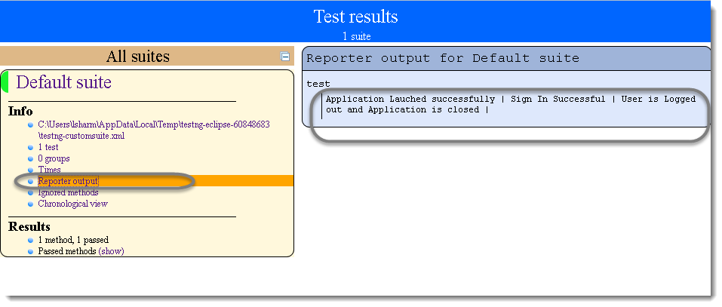
After executing the program, your Reporters log will look like this:

Slide 58
TestNG Asserts
TestNG also gives us the power to take decisions in the middle of the test run with the help of Asserts. With this we can put various checkpoints in the test. Asserts are the most popular and frequently used methods while creating Selenium Scripts. In selenium there will be many situations in the test where you just like to check the presence of an element. All you need to do is to put an assert statement on to it to verify its existence.
Different Asserts Statements:
Assert.assertTrue() & Assert.assertFalse()
Assert.assertEquals()

Slide 59
Assert.assertTrue() & Assert.assertFalse()
Program:
package automationFramework;
import java.util.concurrent.TimeUnit;
import org.openqa.selenium.By;
import org.openqa.selenium.WebDriver;
import org.openqa.selenium.WebElement;
import org.openqa.selenium.firefox.FirefoxDriver;
import org.testng.Assert;
import org.testng.annotations.Test;
public class Asserts {
private static WebDriver driver;

Slide 60
@Test public void f() { System.setProperty("webdriver.chrome.driver","C:\\NewFrameWorkAutomation\\POM\\lib\\chromedriver.exe"); WebDriver driver = new ChromeDriver(); driver.manage().timeouts().implicitlyWait(10, TimeUnit.SECONDS); driver.get("http://magento2-demo.nexcess.net/"); // Here driver will try to find out Sign in link on the application driver.findElement(By.linkText("Sign In")).click(); //Test will only continue, if the below statement is true //This is to check whether the link is displayed or not Assert.assertTrue(Sign In.isDisplayed()); //Sign in will be clicked only if the above condition is true

Slide 61
Sign In.click(); } } Note: Assert true statement fails the test and stop the execution of the test, if the actual output is false. Assert.assertFalse() works opposite of Assert.assertTrue(). It means that if you want your test to continue only if when some certain element is not present on the page. You will use Assert false, so it will fail the test in case of the element present on the page.

Slide 62
Assert.assertEquals()
Program:
@Test
public void test() {
String sValue = "Lakshay Sharma";
System.out.println(" What is your full name");
Assert.assertEquals("Lakshay Sharma", sValue);
System.out.println(sValue);
}
It also works the same way like assert true and assert fail. It will also stop the execution, if the value is not equal and carry on the execution, if the value is equal.

Slide 63
TestNG Parameters & Data Provider
TestNG Parameters
It allows us to automatically run a test case multiple times with different input and validation values. As Selenium Webdriver is more an automated testing framework than a ready-to-use tool, you will have to put in some effort to support data driven testing in your automated tests. I usually prefer to use Microsoft Excel as the format for storing my parameters but so many of my followers have requested to write an article on TestNG Data Provider.
TestNG again gives us another interesting feature called TestNG Parameters. TestNG lets you pass parameters directly to your test methods with your testng.xml.

Slide 64
Scenarios:
Let me take a very simple example of LogIn application, where the username and password is required to clear the authentication.
Create a test on my demo default magento 2 application to perform LogIn which takes the two string argument as username & password.
Provide Username & Password as parameter using TestNG Annotation.
Program :
package automationFramework;
import java.util.concurrent.TimeUnit;
import org.openqa.selenium.By;
import org.openqa.selenium.WebDriver;
import org.openqa.selenium.chrome.ChromeDriver;
import org.testng.annotations.Test;

Slide 65
import org.testng.annotations.Parameters; public class TestngParameters { private static WebDriver driver; @Test @Parameters({ "sUsername", "sPassword" }) public void test(String sUsername, String sPassword) { System.setProperty("webdriver.chrome.driver","C:\\NewFrameWorkAutomation\\POM\\lib\\chromedriver.exe"); WebDriver driver = new ChromeDriver(); driver.manage().timeouts().implicitlyWait(10, TimeUnit.SECONDS); driver.get("http://magento2-demo.nexcess.net/"); driver.findElement(By.linkText("Sign In")).click();

Slide 66
driver.findElement(By.id(“email")).sendKeys(sUsername); driver.findElement(By.id(“pass")).sendKeys(sPassword); driver.findElement(By.id("send2")).click(); driver.quit(); } }

Slide 67
The parameter would be passed values from testng.xml which we will see in the next step.
<suite name="Suite">
<test name="ToolsQA">
<parameter name="sUsername" value="testuser_1"/>
<parameter name="sPassword" value="Test@123"/>
<classes>
<class name="automationFramework.TestngParameters" />
</classes>
</test>
</suite>
Now, run the testng.xml, which will run the parameterTest method. TestNG will try to find a parameter named sUsername & sPassword.

Slide 68
TestNG DataProviders
When you need to pass complex parameters or parameters that need to be created from Java (complex objects, objects read from a property file or a database, etc…), in such cases parameters can be passed using Dataproviders. A Data Provider is a method annotated with @DataProvider. A Data Provider returns an array of objects.
Scenario:
Define the method credentials() which is defined as a Dataprovider using the annotation. This method returns array of object array.
Add a method test() to your DataProviderTest class. This method takes two strings as input parameters.
Add the annotation @Test(dataProvider = “Authentication”) to this method. The attribute dataProvider is mapped to “Authentication”.

Slide 69
Program:
import org.openqa.selenium.WebDriver;
import org.openqa.selenium.chrome.ChromeDriver;
import org.testng.annotations.DataProvider;
import org.testng.annotations.Test;
public class DataProviderTest {
private static WebDriver driver;
@DataProvider(name = "Authentication")
public static Object[][] credentials() {
return new Object[][] { { "monika.assudani@perficient.com", "monika@123" }, {"monika.assudani@perficient.com", "monika@123" }};
}

Slide 70
// Here we are calling the Data Provider object with its Name @Test(dataProvider = "Authentication") public void test(String sUsername, String sPassword) { System.setProperty("webdriver.chrome.driver","C:\\NewFrameWorkAutomation\\POM\\lib\\chromedriver.exe"); driver = new ChromeDriver(); driver.manage().timeouts().implicitlyWait(10, TimeUnit.SECONDS); driver.get("http://magento2-demo.nexcess.net/"); driver.findElement(By.linkText("Sign In")).click(); driver.findElement(By.id("email")).sendKeys(sUsername); driver.findElement(By.id("pass")).sendKeys(sPassword); driver.findElement(By.id("send2")).click(); driver.quit(); }}

Slide 71
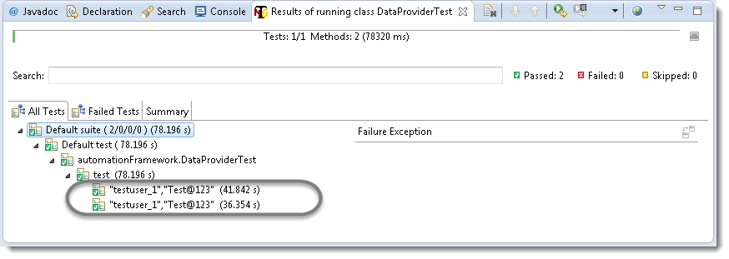
Run the test by right click on the test case script and select Run As > TestNG Test. Give it few minutes to complete the execution, once it is finished the results will look like this in the TestNg Result window.
Note: As the test data is provided two times, the above test executed two times completely.

Slide 72
TestNG DataProvider with Excel

Slide 73
Multi Browser & Parallel Testing
Multi Browser
In every project it is required to perform multi-browser testing to make sure that the functionality is working as expected with every browser to give equal user experience to all of the wide range of audience. It takes a considerable time to test everything on every browser and when we have used automation to reduce the testing efforts then why don’t we perform the multi-browser testing using automation. TestNG gives us functionality to perform same test on different browsers in a simple and easy way.
Scenario:
Create your Script to test a LogIn application using TestNG class.
Pass ‘Browser Type’ as parameters using TestNG annotations to the before method of the TestNG class. This method will launch only the browser, which will be provided as parameter.

Slide 74
Program:
package automationFramework;
import org.openqa.selenium.By;
import org.openqa.selenium.WebDriver;
import org.openqa.selenium.chrome.ChromeDriver;
import org.openqa.selenium.ie.InternetExplorerDriver;
import org.testng.annotations.AfterClass;
import org.testng.annotations.BeforeClass;
import org.testng.annotations.Parameters;
import org.testng.annotations.Test;
public class MultiBrowser {

Slide 75
public WebDriver driver;
@Parameters("browser")
@BeforeClass
// Passing Browser parameter from TestNG xml
public void beforeTest(String browser) {
// If the browser is Firefox, then do this
if(browser.equalsIgnoreCase(“chrome")) {
driver = new chromeDriver();
// If browser is IE, then do this
}else if (browser.equalsIgnoreCase("ie")) {
// Here I am setting up the path for my IEDriver
System.setProperty("webdriver.ie.driver", "Path of the IE browser");
driver = new InternetExplorerDriver(); }

Slide 76
// Doesn't the browser type, lauch the Website
driver.get("http://magento2-demo.nexcess.net/");
}
// Once Before method is completed, Test method will start
@Test public void login() throws InterruptedException {
driver.findElement(By.linkText("Sign In")).click();
driver.findElement(By.id("email")).sendKeys("monika.assudani@perficient.com");
driver.findElement(By.id("pass")).sendKeys("monika@123");
driver.findElement(By.id("send2")).click();
}
@AfterClass public void afterTest() {
driver.quit();
} }

Slide 77
Create a TestNG XML for running your test. Configure the TestNG XML for passing parameters i.e. to tell which browser should be used for Running the Test
<?xml version="1.0" encoding="UTF-8"?>
<!DOCTYPE suite SYSTEM "http://testng.org/testng-1.0.dtd">
<suite name="Suite" parallel="none">
<test name="FirefoxTest">
<parameter name="browser" value="firefox" />
<classes>
<class name="automationFramework.MultiBrowser" />
</classes>
</test>
</suite>

Slide 78
<test name="IETest">
<parameter name="browser" value="ie" />
<classes>
<class name="automationFramework.MultiBrowser" />
</classes>
</test>
Note: You can set any number of Browsers here and just for the example purpose I have set up only two main browsers.

Slide 79
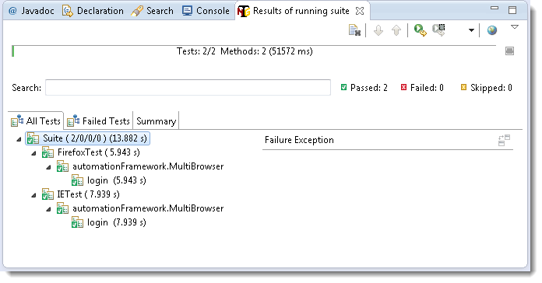
Now it’s time to run the xml. Run the test by right click on the testng.xml file and select Run As > TestNG Suite.
Note: TestNg will execute the test one by one. You may like to perform parallel tests, next topic will cover that.

Slide 80
Parallel Tests using TestNG
Using the feature provided by TestNG for Parallel Executions. just take the above example for Sign In application with two different browsers. This time all we want is to execute test in both browsers simultaneously.
Now just set the ‘parallel‘ attribute to ‘tests‘ in the above used xml and give a run again. This time you will notice that your both browsers will open almost simultaneously and your test will run in parallel.

Slide 81
Program:
<?xml version="1.0" encoding="UTF-8"?>
<!DOCTYPE suite SYSTEM "http://testng.org/testng-1.0.dtd">
<suite name="Suite" parallel="tests">
<test name="FirefoxTest"
<parameter name="browser" value="firefox" />
<classes>
<class name="automationFramework.MultiBrowser" />
</classes>
</test>
<test name="IETest">
<parameter name="browser" value="ie" />

Slide 82
<classes>
<class name="automationFramework.MultiBrowser" />
</classes>
</test>
</suite>
Note: You may see some intermittent issues using parallel testing. I will not recommend you this rather run one by one only.

Slide 83

Any Questions?

